Slide 1
Week 2
SQL Review

Slide 2
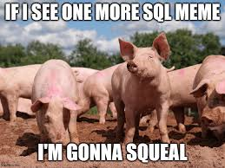
What is SQL
SQL or Structured Query Language is how we can interact with our database
SQL can be used to view, organize and manage the data
SQL commands or queries are done on the command prompt and look similar to command line commands
SQL is relatively human readable once you're used to the syntax
Scripts can be written to automate things and make queries more efficient to use

Slide 3
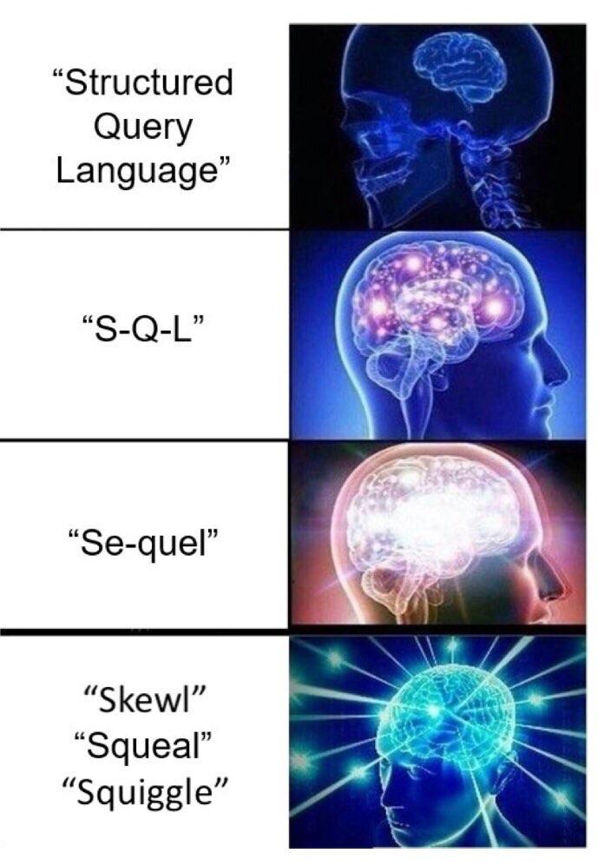
SQL and mySQL
SQL or Structured Query Language is how you interact with a relational database
SQL is the language
MySQL is the database
Might hear S Q L
Might hear See-quil (or sequel)
The language is used to ask questions of your database

Slide 4

Why it's so popular
SQL is interactive, so you can see your results pretty fast and make sure you're looking at the right info
It's close enough to programming a lot of developers are very comfortable learning it quickly
Because it's popular a lot of people learn and use it, therefore making it more popular
SQL is relatively dependable and has been in use so long a lot of people have done a lot of testing on it
Once it's setup correctly a company is unlikely to move away into a new technology
Because SQL is relatively human readable a lot of people use it in companies including marketing, QA and sales, some larger companies will even offer free courses for people to learn it

Slide 5
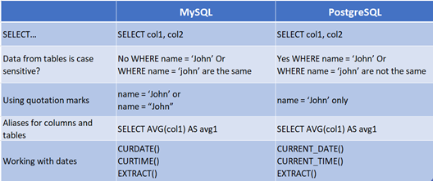
SQL the Brand
SQL was standardized in the 80s, but there are different dialects depending on what database you're using
SQL server is proprietary and owned by MS
Dialects including PostgreSQL and SQLite
For example PostgreSQL is open source and for Object oriented databases (we've been talking about relational), and can also suppose JSON data types
https://christy-g-lee.medium.com/sql-dialects-postgresql-vs-mysql-fb9c15eef7fb

Slide 6
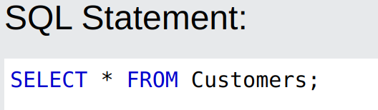
Breakdown of a basic query
For right now we're just using basic SQL standard
Each table in our database will have fields, each record will have a row and column. We need to know what we want to look at to form our query properly
Each SQL query is going to start and include commands such as SELECT, UPDATE, INSERT and DELETE
You want to figure out what you want first, and then try and translate it into a query. For example if you want to look at all customers in your database you might say "SELECT * FROM Customers;"
SELECT is saying what you want
The * indicates you want everything
FROM is where you're getting the info
Customers is the table we're pulling from

Slide 7
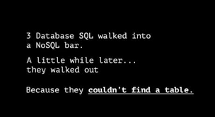
Activity: Try Basic query
If you are a beginner and have never seen SQL and are not comfortable programming try https://www.w3schools.com/sql/sql_syntax.asp and see some examples, and try your own
If you want more of a challenge try the Adventure Island! Or one of the other challenges:
http://wwwlgis.informatik.uni-kl.de/extra/game/?lang=en
https://sqlpd.com/

Slide 8
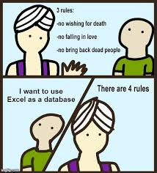
SQL ascending and descending
We can also easily organize our data
Asking the database to give results in any order or organizational pattern we want without changing the data can give us the ability to play with the data in more ways.
SQL has the options of Ascending or Descending
These are denoted by ASC and DESC keywords
These are used by saying ORDER BY
In SQL this might look like
SELECT * FROM books_table ORDER BY cost desc;

Slide 9
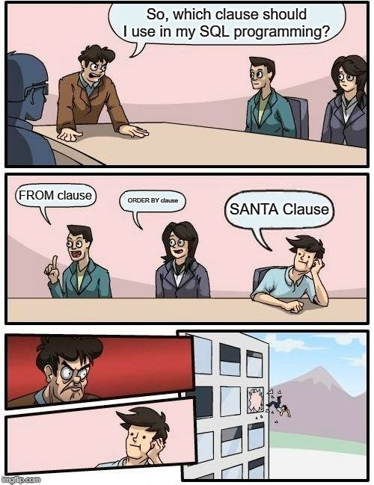
SQL filters
We can also use filters or groupings to get data out of the database
FILTER can show particular pieces of data
One example of filtering data is using the following symbols
Equal =
Not Equal !=
Greater than >
Less than <
For example you could see all books that cost less than $10, or more then $5 or cost equal to $9.99
An example of how this might look in a SQL command would be
SELECT * FROM books_table WHERE price < 10;
SELECT * FROM books_table WHERE price = 9.99;

Slide 10

Adding in multiple options
We can also use AND OR to get multiple options selected
For example, if you wanted to look at books that cost less than $10 AND were published in the last 10 years
An example of how this might look in a SQL command would be
SELECT * FROM books_table WHERE price < 10 AND publish_date > 2015;

Slide 11
SQL distinct
We could also look for items that are unique, or distinct using SQL
This would allow us to look at data without duplication
Example use cases:
If we wanted to make sure we have unique library patrons, we could look for addresses to make sure we are only seeing unique addresses and no duplicates
Looking at books we might want to make sure we are looking at a distinct or unique catalog of books, without duplication so we can take accurate inventory of what we might be missing

Slide 12

Other functions with SQL
SQL has a number of other functions and keywords that are helpful as well
CAUTION: The type of SQL you're using affects what functions there are and how they are labelled.
Some functions are there in all the common dialects of SQL and look the same
https://en.wikibooks.org/wiki/SQL_Dialects_Reference has some examples of what functions look like by dialect
For example, if you wanted to find Natural logarithm of x
Standard SQL says it's LN(x)
MSSQL says it's LOG(x)
MySQL says it can be either one

Slide 13
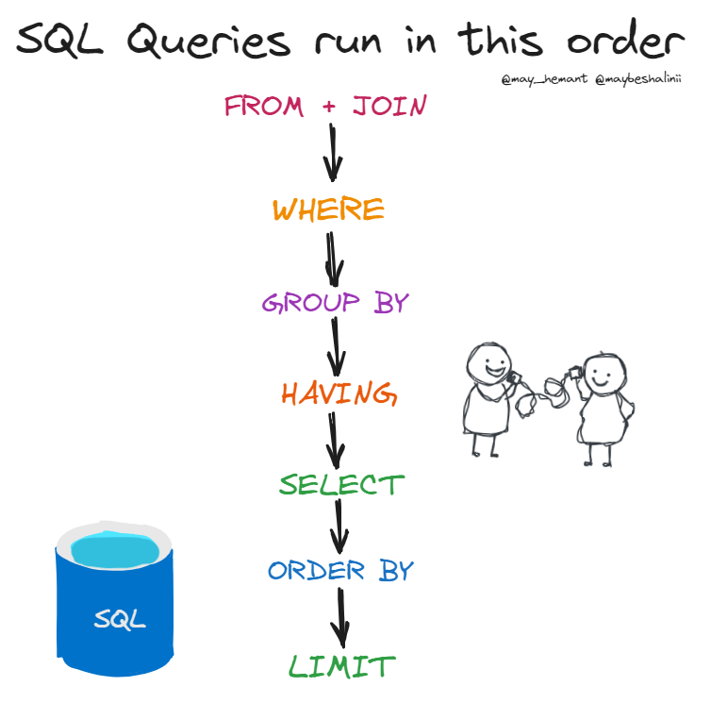
How SQL queries are processed
https://twitter.com/maybeshalinii/status/1728363137903267905

Slide 14
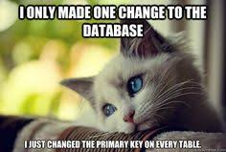
Primary Keys
Unique Identifier
Used to be Numeric only
You're NOT supposed to use data (i.e not social security numbers) but people do
Microsoft refers to primary keys as ID
Modern trend has been to make Primary keys GUID or UUID instead of numeric to make parallelism easier
Example of a guid: e2bd848b-3472-49ab-8836-9ff21aaf8c56
Used to make sure if multiple systems are entering in data they don’t use the same key
Won't create chokepoint the way incremental key generation might
Windows people might use guid, Unix people might say uuid.

Slide 15
Foreign keys
Also called functionally dependent keys
Abbreviated FD
Point to table with the data
Always point to a primary key
In other words is a way to link data between tables in your database
Some databases call both foreign key AND primary key the ID (<--BADBAD)

Slide 16
Primary key vs Foreign key
Primary Key | Foreign Key
Ensures unique Data | Shows relationship between tables
Only 1 primary key allowed | More than one allowed
Cannot have Null Values | Can have Null Value
Value can't be deleted | Value can be deleted

